Slide 1

MINI PROJECT
ABNORMAL ACTIVITY DETECTION
Name of Guide/Mentor
Dr. Manoj Sharma
Name of Students
Vrittik Sharma (05611502817)
Vaibhav Suri (05511502817)
Ujjwal Gaba (05311502817)
Pratyush Raj (03411502817)

Slide 2
CONTENTS
Introduction
Problem statement
Expected Project Outcomes
Technical Stack
Dataset Used
Basic Overflow
Methodology
Result
Conclusion

Slide 3
SPEECH EMOTION ANALYSIS
Speech emotion analysis refers to the use of various methods to analyze vocal behavior as a marker of affect e.g.,emotions, moods, and stress), focusing on the nonverbal aspects of speech. The basic assumption is that there is a set of objectively measurable voice parameters that reflect the affective state a person is currently experiencing (or expressing for strategic purposes in social interaction).
This assumption appears reasonable given that most affective states involve physiological reactions (e.g., changes in the autonomic and somatic nervous systems), which in turn modify different aspects of the voice production process.

Slide 4
PROBLEM STATEMENT
Speech plays an important role in identifying the tone of a person, and tone in turn helps in identifying the behaviour of a person. The problem is to make a machine classify human behaviour as normal and abnormal based on speech produced by the person.
The problem is divided into 2 subtasks, one is making an indian dataset of speech and training the machine with it and the other is to train the machine with a foreign dataset of speech and then comparing both in terms of accuracy.

Slide 5
EXPECTED PROJECT OUTCOMES
The Outcomes are as follows :
Indian Dataset of speech with different emotions
Training model for ravdess dataset to determine abnormal and normal behavior of a person
Training model for Indian speech dataset
Compared analysis of ravdess and Indian Dataset for analysing the person's behavior (abnormal or normal)

Slide 6
TECHNICAL STACK
Software Used
Python 3
Spyder
Libraries Used
TensorFlow
Numpy
Pandas
Librosa
Keras
Specgram

Slide 7
DATASETS USED
The Ryerson Audio-Visual Database of Emotional Speech and Song (RAVDESS)
Indian EmoSpeech Command Dataset: A dataset for emotion based speech recognition in the wild

Slide 8
BASIC WORKFLOW
Indian Emo Speech Dataset
Ravdess Dataset
Preprocessing
Preparing Training and Test Dataset
CNN Classifier
Testing the Model
Preprocessing
Preparing Training and Test Dataset
CNN Classifier
Testing the Model
RESULT
RESULT
RESULTS AND EFFICIENCY COMPARED

Slide 9
PROCESS DESCRIPTION
Preprocessing on data set
Training the dataset
Testing the dataset
Emotion was recognised using model
Comparing the accuracy of both model

Slide 10
PREPROCESSING(NOISE REDUCTION)
Noise reduction is the process of removing noise from a signal .
It is used to remove the background noises to improve the performance of the model trained over the audio files
It is done by calculating the mel- frequency coefficients.
The frequency coefficients having the null values or zero cepstrals
indicates background noise only.
The audio files having these characters are removed accordingly.

Slide 11

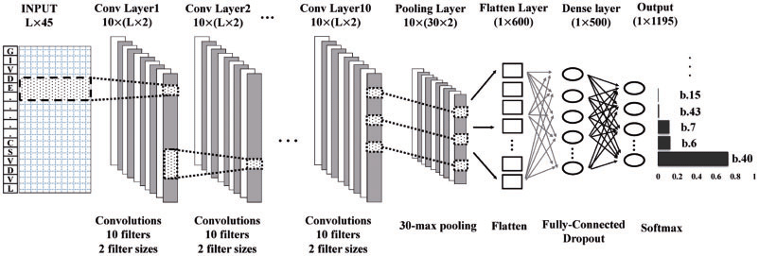
CNN ALGORITHM
A convolutional neural network (CNN) is a specific type of artificial neural network that uses perceptrons, a machine learning unit algorithm, for supervised learning, to analyze data.
We used CNN for training our model

Slide 12
Training and Testing The Model
Ravdess Dataset
Emotion | Speech Sample Count | Song Sample Count | Summed Count
Normal(Neutral,Calm,Happy) | 96+192+192 | 92+184+184 | 940
Abnormal(Sad,Angry,Fearful,Disgust,Surprised) | 192+192+192+192+192 | 184+184+184+0+0 | 1512
Total | 1440 | 1012 | 2452
Indian Dataset
Emotion | Speech Sample Count
Normal(Happy,Calm) | 834
Abnormal(Angry,Fearful) | 723
Total | 1557

Slide 13
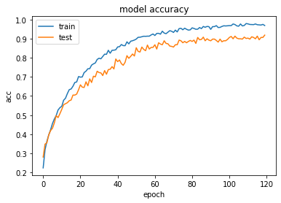
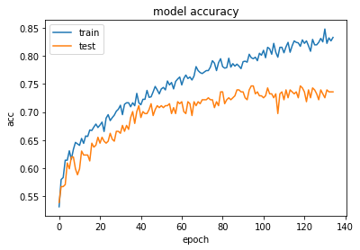
RESULTS
Ravdess Dataset
Indian Dataset

Slide 14
CONTINUED...
Accuracy obtained from Ravdess Dataset is 94.6% and that of Indian dataset is 73.49%.
The confusion matrix of both the ravdess and Indian dataset obeys the accuracy point of view.

Slide 15
CONCLUSION
In this project we presented Abnormal Activity Detection System using CNN machine learning algorithm to identify abnormal activities .
We used two speech corpus namely RAVDESS DATASET , INDIAN EMOSPEECH DATASET
The model trained on ravdess dataset is showing accuracy of 94.6% and accuracy of Indian dataset is 73.49% . The Emospeech dataset is showing lesser accuracy due to the fact that there are more noise factors affecting the useful tone and pitch information , its calibration can be done by adding more speech data to the dataset.

